Slide 2
About Today…
Handling routes
HTTP Methods
Middlewares

Slide 3
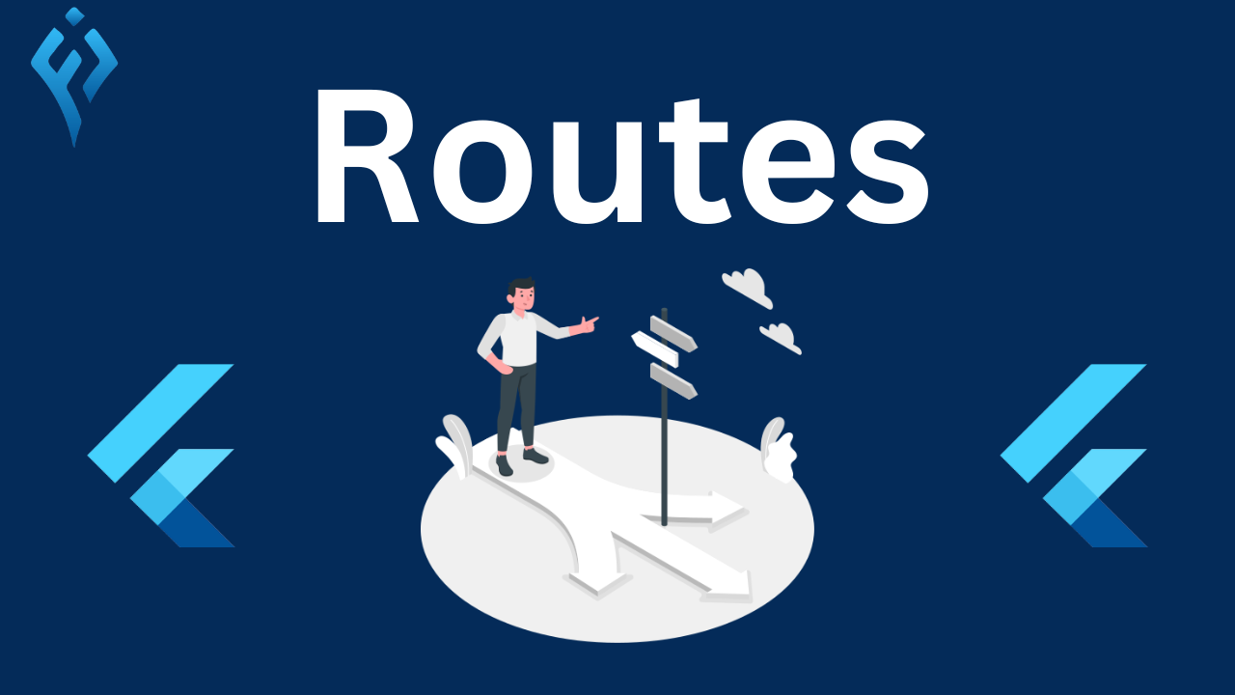
HANDLING

Slide 4
What are routes
Definition
Routes define the paths or URLs in your application
Importance
Routes determine how your application responds to client requests

Slide 5
Types of Routes
Static Routes
Fixed paths that don't change
/home
/about
/contact
Dynamic Routes
Paths with parameters or placeholders
/users/:id
/products/:category

Slide 6
HTTP Methods
Actions that clients can perform on the server
GET
Purpose
Retrieve data from the serve
Usage
Used for fetching resources like web pages, images, or API data
Example
GET /api/users to fetch a list of users
POST
Purpose
Send data to the server to create a new resource
Usage
Used for form submissions, creating new records, or sending data to APIs
Example
POST /api/users to create a new user.
PUT
Purpose
Update existing data on the server
Usage
Typically used to update specific resources identified by a unique identifier
Example
PUT /api/users/:id to update user details
DELETE
Purpose
Remove data or resources from the server
Usage
Used to delete specific resources identified by a unique identifier
Example
DELETE /api/users/:id to delete a user by ID

Slide 7

Routing in Express
Define routes using Express syntax
Routing Parameters
Purpose
Capture dynamic values from URLs
Syntax
Use colon notation in route paths (/:param).
Example
GET /users/:id to fetch user details by ID

Slide 8

Middlewares in Express
Definition
Functions that run during route handling
Usage
Perform tasks like authentication, logging, or data validation
Example
Implement middleware for logging requests

Slide 9

What does a route define in a Node.js application?
The URL path and HTTP request method
Which HTTP method is typically used for retrieving data from a server?
GET
In Express.js, how would you define a route for handling a POST request to create a new user?
app.post('/users', ...)
What is the purpose of middleware in Express.js?
To process requests and responses in the middleware stack
What is the purpose of middleware in Express.js?
To process requests and responses in the middleware stack

Slide 10

Task
Create a simple Express.js application that handles user data using routes, HTTP methods, and middleware

